Slide 1
Forest Park Southeast, Botanical Heights, Central West End, Medical Campus
Monthly Crime report: December 2019 Washington University Medical Center

Slide 2
Forest Park Southeast: Summary Notes
40 total crimes in December 2019
300% change compared to December 2018 (10 total crimes)
7 crime(s) against persons in December 2019
40% change compared to December 2018 (5 crimes against persons)
327 total crimes in 2019
70% change compared to this time in 2018 (192 total crimes)
47 crime(s) against persons in 2019
-6% change compared to this time in 2018 (50 crimes against persons)

Slide 3
Forest Park Southeast: Year to Year Comparison
Part 1 Crimes | Jan | Feb | Mar | Apr | May | Jun | Jul | Aug | Sep | Oct | Nov | Dec | Total
Aggravated Assault | 1 | 2 | 0 | 3 | 7 | 4 | 4 | 3 | 1 | 7 | 0 | 3 | 35
Arson | 0 | 0 | 1 | 0 | 0 | 0 | 0 | 0 | 0 | 0 | 0 | 0 | 1
Burgalry | 0 | 1 | 1 | 3 | 0 | 1 | 1 | 1 | 0 | 1 | 0 | 0 | 9
Homicide | 1 | 0 | 0 | 0 | 0 | 0 | 0 | 0 | 0 | 0 | 0 | 0 | 1
Larceny | 5 | 5 | 5 | 8 | 20 | 4 | 14 | 11 | 15 | 7 | 10 | 3 | 107
Motor Vehicle Theft | 2 | 1 | 2 | 0 | 3 | 3 | 3 | 2 | 2 | 2 | 2 | 2 | 24
Robbery | 0 | 0 | 1 | 1 | 1 | 4 | 2 | 1 | 0 | 2 | 1 | 2 | 15
Total | 9 | 9 | 10 | 15 | 31 | 16 | 24 | 18 | 18 | 19 | 13 | 10 | 192
Part 1 Crimes | Jan | Feb | Mar | Apr | May | Jun | Jul | Aug | Sep | Oct | Nov | Dec | Total
Aggravated Assault | 0 | 3 | 1 | 2 | 2 | 4 | 2 | 0 | 2 | 5 | 0 | 5 | 26
Arson | 0 | 0 | 1 | 0 | 0 | 1 | 0 | 0 | 0 | 0 | 0 | 0 | 2
Burgalry | 0 | 0 | 1 | 1 | 0 | 0 | 3 | 1 | 4 | 8 | 3 | 1 | 22
Homicide | 0 | 0 | 0 | 0 | 0 | 0 | 0 | 0 | 1 | 0 | 0 | 0 | 1
Larceny | 7 | 10 | 15 | 12 | 9 | 21 | 17 | 19 | 24 | 35 | 17 | 32 | 218
Motor Vehicle Theft | 3 | 6 | 1 | 2 | 0 | 4 | 6 | 1 | 8 | 3 | 3 | 0 | 37
Robbery | 1 | 0 | 1 | 1 | 2 | 5 | 2 | 1 | 2 | 3 | 1 | 2 | 21
Total | 11 | 19 | 20 | 18 | 13 | 35 | 30 | 22 | 41 | 54 | 24 | 40 | 327

Slide 4
Forest Park Southeast: Summary Tables
Part 1 Crimes | Number of Crimes
Aggravated Assault | 5
Burgalry | 1
Larceny | 32
Robbery | 2
Total | 40
Day of the Week | Number of Crimes
Sun | 8
Mon | 1
Tue | 4
Wed | 3
Thu | 6
Fri | 10
Sat | 8
Total | 40
Crimes Against Persons | Number of Crimes
FALSE | 33
TRUE | 7
Total | 40
Time of Day | Number of Crimes
Day | 30
Night | 10
Total | 40

Slide 5
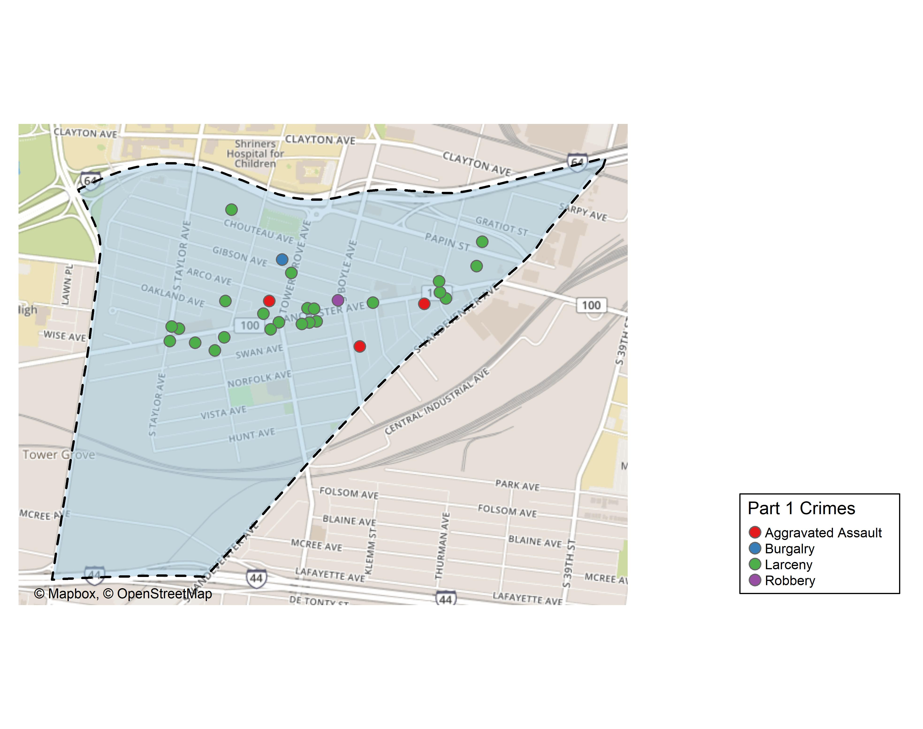
Forest Park Southeast: Total Crime Map

Slide 6
Botanical Heights: Summary Notes
11 total crimes in December 2019
38% change compared to December 2018 (8 total crimes)
7 crime(s) against persons in December 2019
40% change compared to December 2018 (5 crimes against persons)
87 total crimes in 2019
-22% change compared to this time in 2018 (112 total crimes)
16 crime(s) against persons in 2019
78% change compared to this time in 2018 (9 crimes against persons)

Slide 7
Botanical Heights: Year to Year Comparison
Part 1 Crimes | Jan | Feb | Mar | Apr | May | Jun | Jul | Aug | Sep | Oct | Nov | Dec | Total
Aggravated Assault | 0 | 0 | 1 | 1 | 1 | 2 | 0 | 0 | 0 | 0 | 1 | 1 | 7
Arson | 0 | 0 | 0 | 0 | 0 | 0 | 0 | 0 | 0 | 0 | 0 | 0 | 0
Burgalry | 1 | 2 | 0 | 1 | 3 | 2 | 0 | 8 | 3 | 4 | 2 | 5 | 31
Homicide | 0 | 0 | 0 | 0 | 0 | 0 | 0 | 0 | 0 | 0 | 0 | 0 | 0
Larceny | 14 | 1 | 6 | 0 | 4 | 7 | 5 | 8 | 6 | 4 | 4 | 2 | 61
Motor Vehicle Theft | 4 | 0 | 1 | 0 | 1 | 0 | 2 | 1 | 0 | 0 | 2 | 0 | 11
Robbery | 1 | 0 | 0 | 0 | 0 | 0 | 0 | 1 | 0 | 0 | 0 | 0 | 2
Total | 20 | 3 | 8 | 2 | 9 | 11 | 7 | 18 | 9 | 8 | 9 | 8 | 112
Part 1 Crimes | Jan | Feb | Mar | Apr | May | Jun | Jul | Aug | Sep | Oct | Nov | Dec | Total
Aggravated Assault | 0 | 0 | 0 | 0 | 4 | 0 | 0 | 1 | 0 | 0 | 2 | 1 | 8
Arson | 0 | 0 | 0 | 0 | 0 | 0 | 0 | 0 | 0 | 0 | 0 | 0 | 0
Burgalry | 2 | 0 | 0 | 2 | 0 | 0 | 1 | 1 | 3 | 0 | 1 | 2 | 12
Homicide | 0 | 0 | 0 | 0 | 0 | 0 | 0 | 0 | 0 | 0 | 0 | 0 | 0
Larceny | 2 | 3 | 6 | 3 | 3 | 3 | 9 | 1 | 5 | 4 | 3 | 5 | 47
Motor Vehicle Theft | 1 | 1 | 3 | 0 | 1 | 1 | 0 | 1 | 0 | 1 | 1 | 2 | 12
Robbery | 0 | 2 | 0 | 0 | 1 | 1 | 0 | 0 | 0 | 3 | 0 | 1 | 8
Total | 5 | 6 | 9 | 5 | 9 | 5 | 10 | 4 | 8 | 8 | 7 | 11 | 87

Slide 8
Botanical Heights: Summary Tables
Part 1 Crimes | Number of Crimes
Aggravated Assault | 1
Burgalry | 2
Larceny | 5
Motor Vehicle Theft | 2
Robbery | 1
Total | 11
Day of the Week | Number of Crimes
Sun | 0
Mon | 0
Tue | 0
Wed | 2
Thu | 1
Fri | 3
Sat | 5
Total | 11
Crimes Against Persons | Number of Crimes
FALSE | 9
TRUE | 2
Total | 11
Time of Day | Number of Crimes
Day | 10
Night | 1
Total | 11

Slide 9
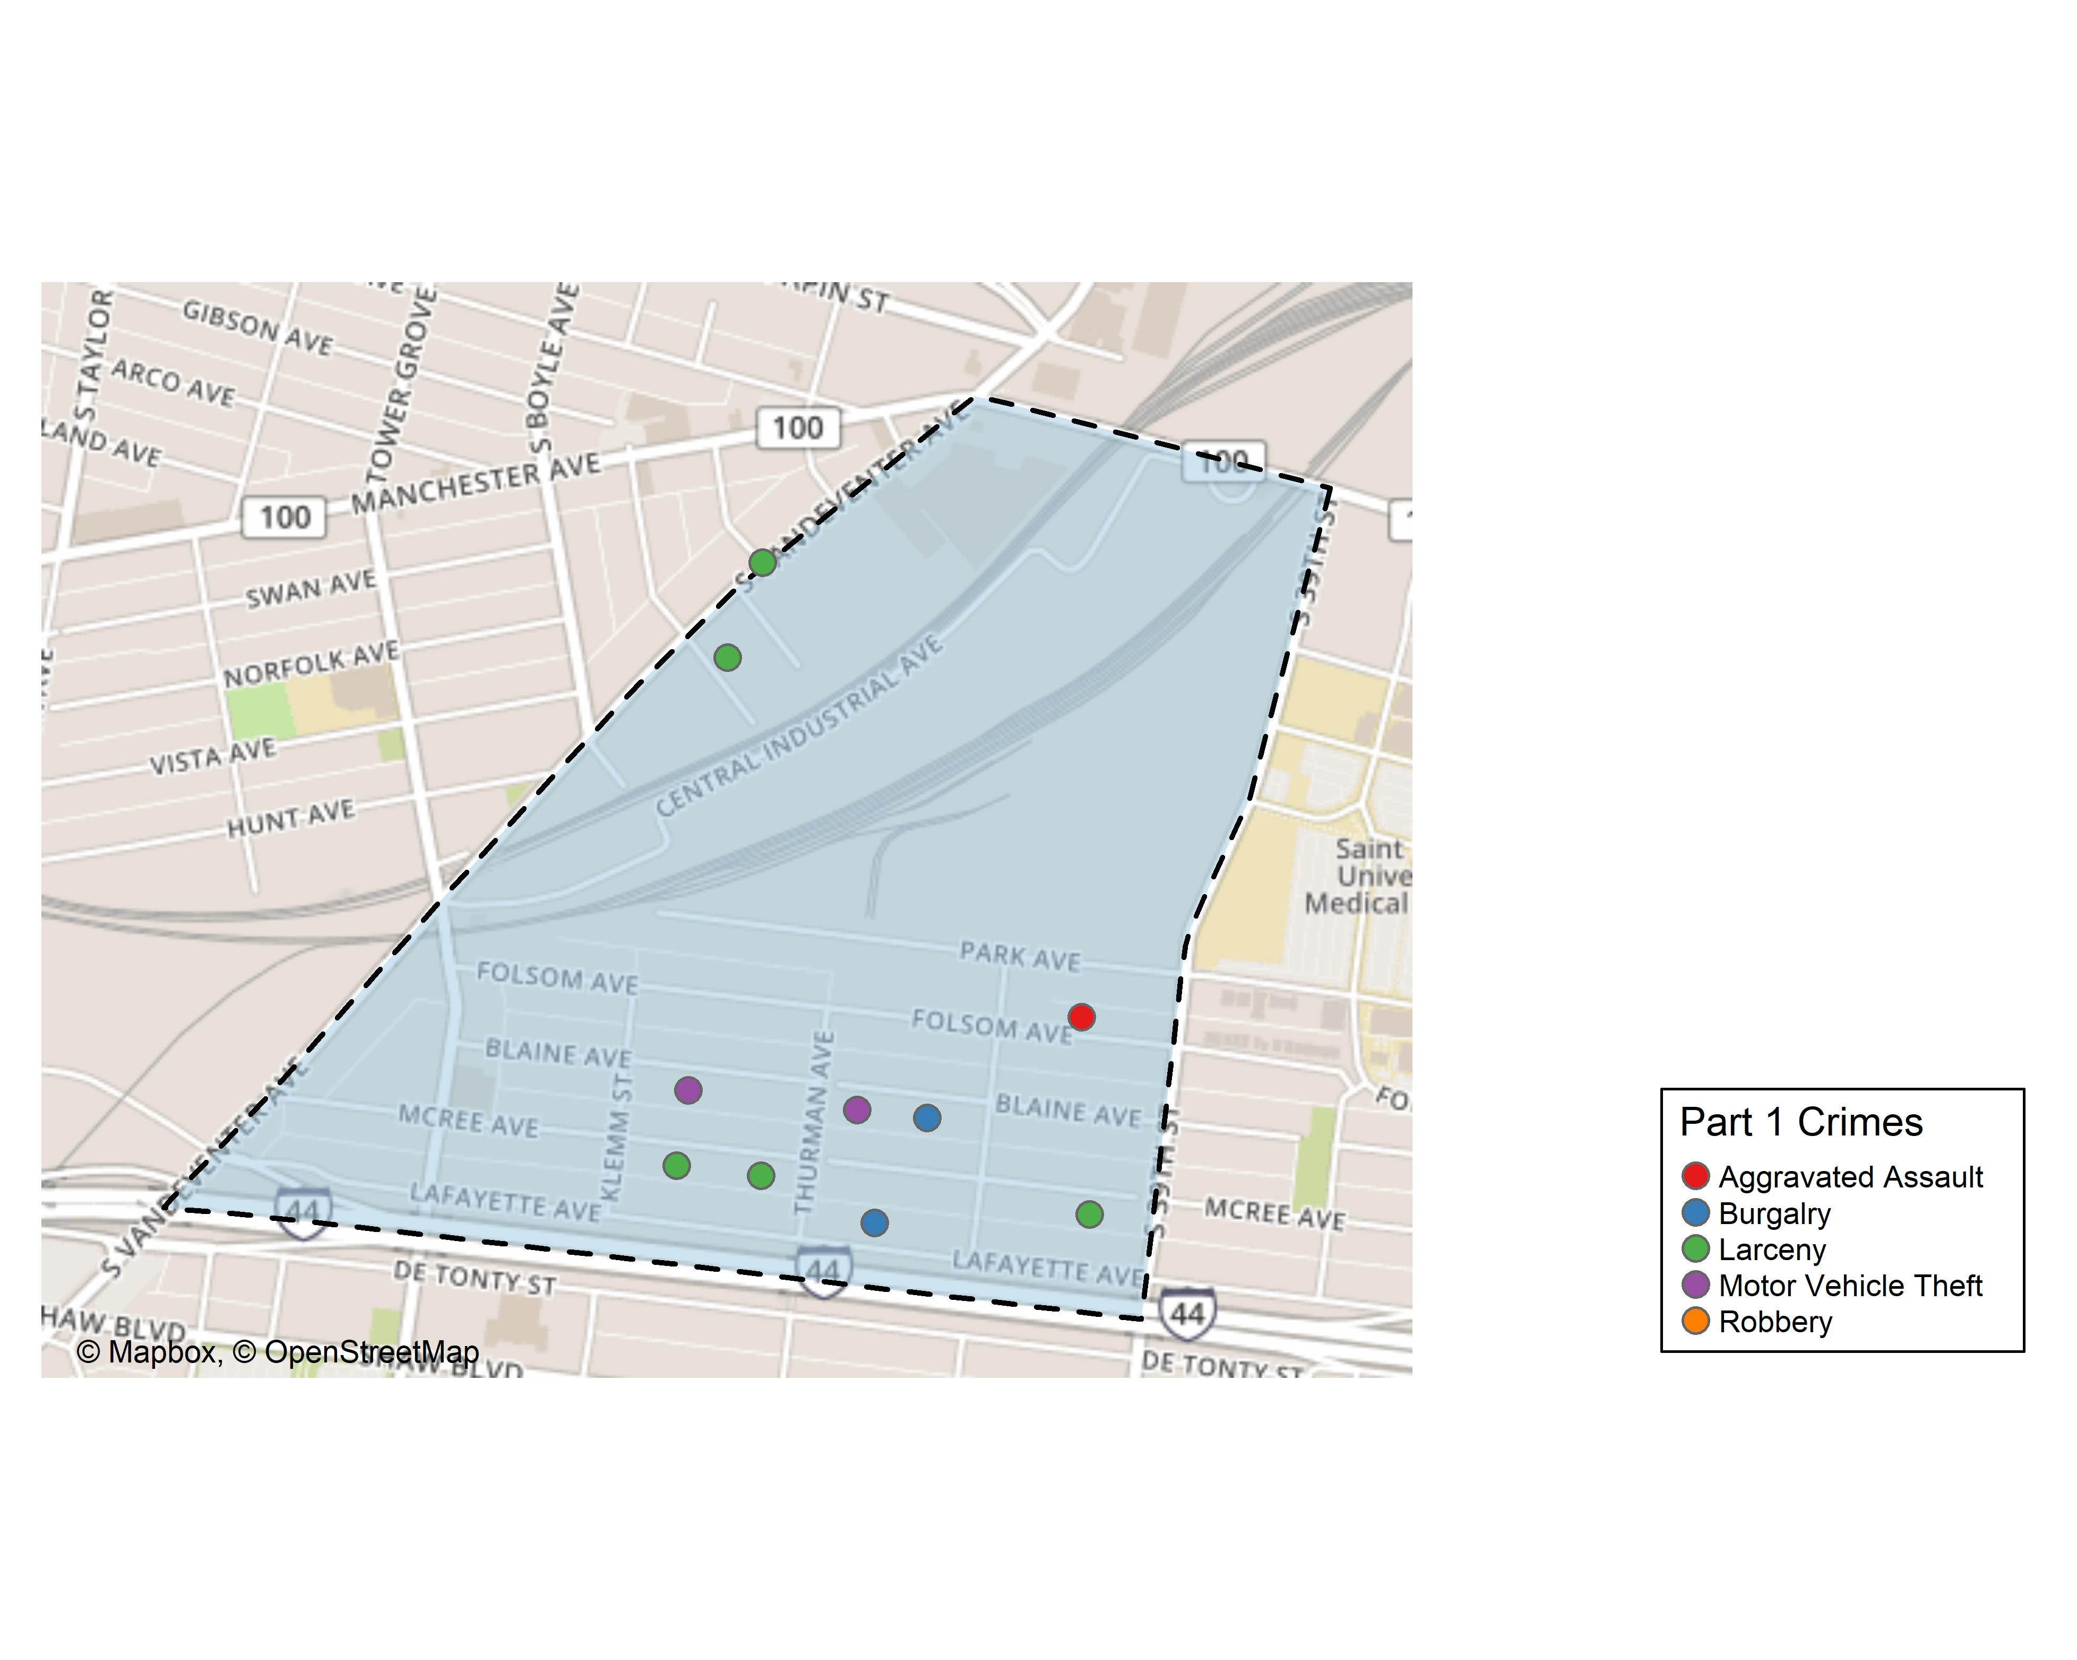
Botanical Heights: Total Crime Map

Slide 10
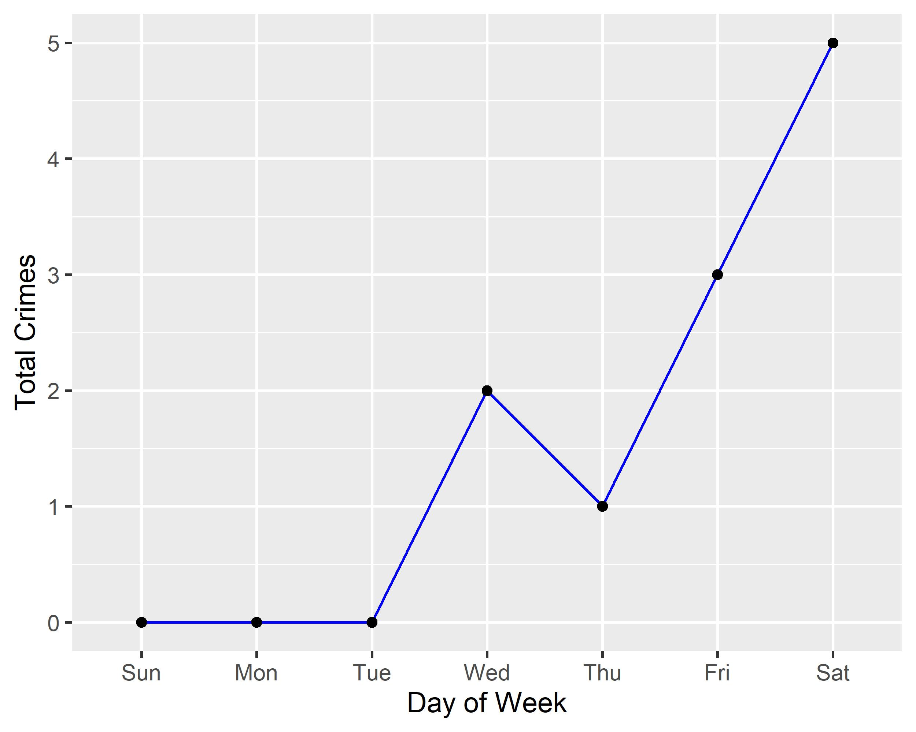
Botanical Heights: Crime by Days of the Week

Slide 11
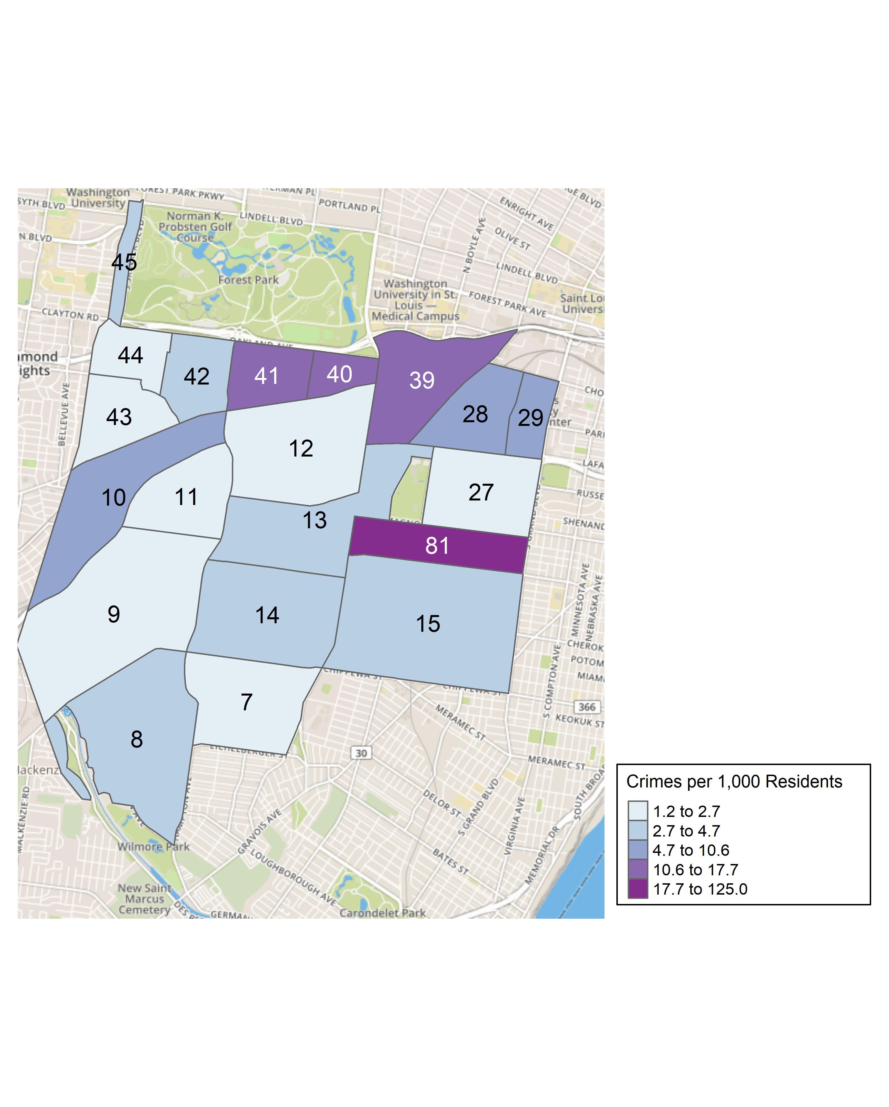
District 2: Crime Rates Map

Slide 12
District 2: Density Map Explanation
There are 23 neighborhoods in District 2. The South Hampton neighborhood is split between District 2 and District 1.
11 total crimes in December 2019
38% change compared to December 2018 (8 total crimes)
2 crime(s) against persons in December 2019
40% change compared to December 2018 (1 crimes against persons)
87 total crimes in 2019
-22% change compared to this time in 2018 (112 total crimes)

Slide 13
Summary Notes: Central West End
100 total crimes in September 2019
33% change compared to September 2018 (75 total crimes)
21 crime(s) against persons in September 2019
31% change compared to September 2018 (16 crimes against persons)
1208 total crimes in 2019
-1% change compared to this time in 2018 (1218 total crimes)
159 crime(s) against persons in 2019
18% change compared to this time in 2018 (135 crimes against persons)

Slide 14
Central West End: Year to Year Comparison
Part 1 Crimes | Jan | Feb | Mar | Apr | May | Jun | Jul | Aug | Sep | Oct | Nov | Dec | Total
Aggravated Assault | 7 | 0 | 1 | 7 | 7 | 11 | 6 | 3 | 7 | 4 | 4 | 10 | 67
Arson | 0 | 0 | 0 | 0 | 0 | 0 | 0 | 0 | 0 | 0 | 0 | 0 | 0
Burgalry | 3 | 5 | 6 | 6 | 7 | 12 | 10 | 16 | 8 | 7 | 11 | 2 | 93
Homicide | 1 | 0 | 0 | 0 | 0 | 0 | 0 | 0 | 0 | 0 | 0 | 0 | 1
Larceny | 95 | 61 | 48 | 52 | 68 | 89 | 130 | 88 | 73 | 82 | 60 | 49 | 895
Motor Vehicle Theft | 8 | 5 | 7 | 10 | 11 | 5 | 7 | 4 | 11 | 11 | 7 | 8 | 94
Robbery | 2 | 2 | 8 | 10 | 1 | 8 | 3 | 10 | 5 | 8 | 5 | 6 | 68
Total | 116 | 73 | 70 | 85 | 94 | 125 | 156 | 121 | 104 | 112 | 87 | 75 | 1,218
Part 1 Crimes | Jan | Feb | Mar | Apr | May | Jun | Jul | Aug | Sep | Oct | Nov | Dec | Total
Aggravated Assault | 9 | 4 | 10 | 2 | 8 | 13 | 4 | 11 | 3 | 8 | 4 | 11 | 87
Arson | 0 | 0 | 1 | 0 | 0 | 0 | 0 | 0 | 0 | 0 | 0 | 0 | 1
Burgalry | 3 | 5 | 5 | 9 | 13 | 8 | 13 | 18 | 8 | 8 | 10 | 5 | 105
Homicide | 0 | 0 | 0 | 0 | 0 | 0 | 0 | 0 | 0 | 0 | 0 | 0 | 0
Larceny | 45 | 66 | 65 | 65 | 72 | 56 | 75 | 81 | 63 | 90 | 89 | 65 | 832
Motor Vehicle Theft | 11 | 7 | 3 | 11 | 12 | 9 | 5 | 11 | 9 | 5 | 19 | 9 | 111
Robbery | 5 | 5 | 2 | 6 | 7 | 3 | 4 | 8 | 3 | 8 | 11 | 10 | 72
Total | 73 | 87 | 86 | 93 | 112 | 89 | 101 | 129 | 86 | 119 | 133 | 100 | 1,208

Slide 15
Central West End: Summary Tables
Part 1 Crimes | Number of Crimes
Aggravated Assault | 11
Burgalry | 5
Larceny | 65
Motor Vehicle Theft | 9
Robbery | 10
Total | 100
Day of the Week | Number of Crimes
Sun | 13
Mon | 13
Tue | 21
Wed | 11
Thu | 22
Fri | 11
Sat | 9
Total | 100
Crimes Against Persons | Number of Crimes
FALSE | 79
TRUE | 21
Total | 100
Time of Day | Number of Crimes
Day | 79
Night | 21
Total | 100

Slide 16
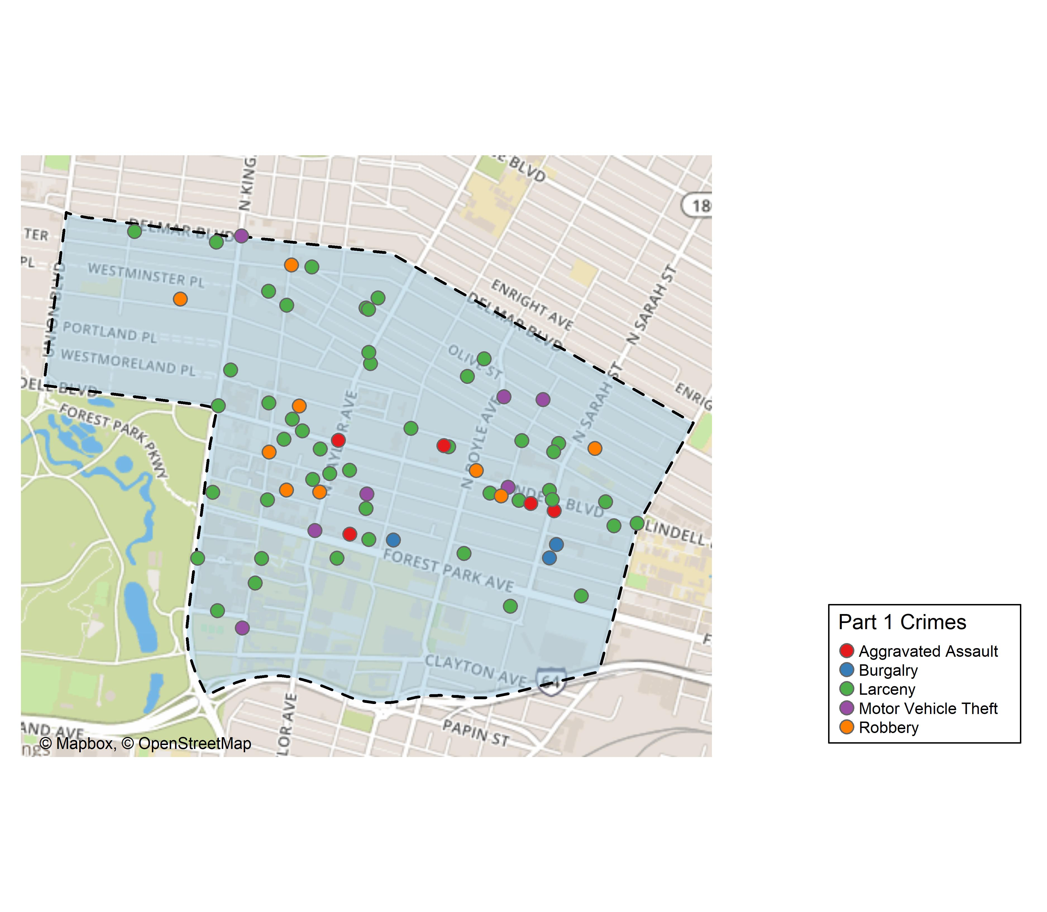
Central West End: Total Crime Map

Slide 17
Washington University Medical Campus: Summary Notes
12 total crimes in December 2019
33% change compared to December 2018 (9 total crimes)
0 crime(s) against persons in December 2019
-100% change compared to December 2018 (1 crimes against persons)
134 total crimes in 2019
33% change compared to this time in 2018 (101 total crimes)
24 crime(s) against persons in 2019
140% change compared to this time in 2018 (10 crimes against persons)

Slide 18
Washington University Medical Campus: Year to Year Comparison
Part 1 Crimes | Jan | Feb | Mar | Apr | May | Jun | Jul | Aug | Sep | Oct | Nov | Dec | Total
Aggravated Assault | 4 | 0 | 1 | 0 | 0 | 1 | 0 | 0 | 0 | 0 | 0 | 1 | 7
Arson | 0 | 0 | 0 | 0 | 0 | 0 | 0 | 0 | 0 | 0 | 0 | 0 | 0
Burgalry | 0 | 0 | 0 | 0 | 0 | 0 | 0 | 0 | 0 | 0 | 0 | 0 | 0
Homicide | 1 | 0 | 0 | 0 | 0 | 0 | 0 | 0 | 0 | 0 | 0 | 0 | 1
Larceny | 13 | 8 | 9 | 11 | 3 | 3 | 2 | 4 | 8 | 5 | 3 | 8 | 77
Motor Vehicle Theft | 1 | 0 | 1 | 3 | 1 | 0 | 0 | 0 | 1 | 3 | 3 | 0 | 13
Robbery | 0 | 0 | 0 | 1 | 0 | 0 | 0 | 0 | 1 | 0 | 1 | 0 | 3
Total | 19 | 8 | 11 | 15 | 4 | 4 | 2 | 4 | 10 | 8 | 7 | 9 | 101
Part 1 Crimes | Jan | Feb | Mar | Apr | May | Jun | Jul | Aug | Sep | Oct | Nov | Dec | Total
Aggravated Assault | 4 | 1 | 1 | 0 | 0 | 2 | 0 | 5 | 3 | 0 | 1 | 0 | 17
Arson | 0 | 0 | 0 | 0 | 0 | 0 | 0 | 0 | 0 | 0 | 0 | 0 | 0
Burgalry | 0 | 0 | 0 | 0 | 0 | 0 | 0 | 1 | 0 | 0 | 0 | 0 | 1
Homicide | 0 | 0 | 0 | 0 | 0 | 0 | 0 | 0 | 0 | 0 | 0 | 0 | 0
Larceny | 7 | 8 | 6 | 9 | 9 | 6 | 8 | 4 | 11 | 6 | 10 | 10 | 94
Motor Vehicle Theft | 2 | 0 | 1 | 2 | 1 | 0 | 0 | 1 | 2 | 0 | 4 | 2 | 15
Robbery | 0 | 0 | 0 | 1 | 0 | 1 | 0 | 1 | 1 | 1 | 2 | 0 | 7
Total | 13 | 9 | 8 | 12 | 10 | 9 | 8 | 12 | 17 | 7 | 17 | 12 | 134

Slide 19
Washington University Medical Campus: Summary Tables
Part 1 Crimes | Number of Crimes
Larceny | 10
Motor Vehicle Theft | 2
Total | 12
Time of Day | Number of Crimes
Day | 11
Night | 1
Total | 12
Type of Larceny | Number of Crimes
All Other | 1
From Building | 3
From Motor Vehicle | 5
Motor Vehicle Parts | 1
Total | 10
Monetary Value | Number of Crimes
$500 - $24,999 | 2
Under $500 | 8
Total | 10

Slide 20
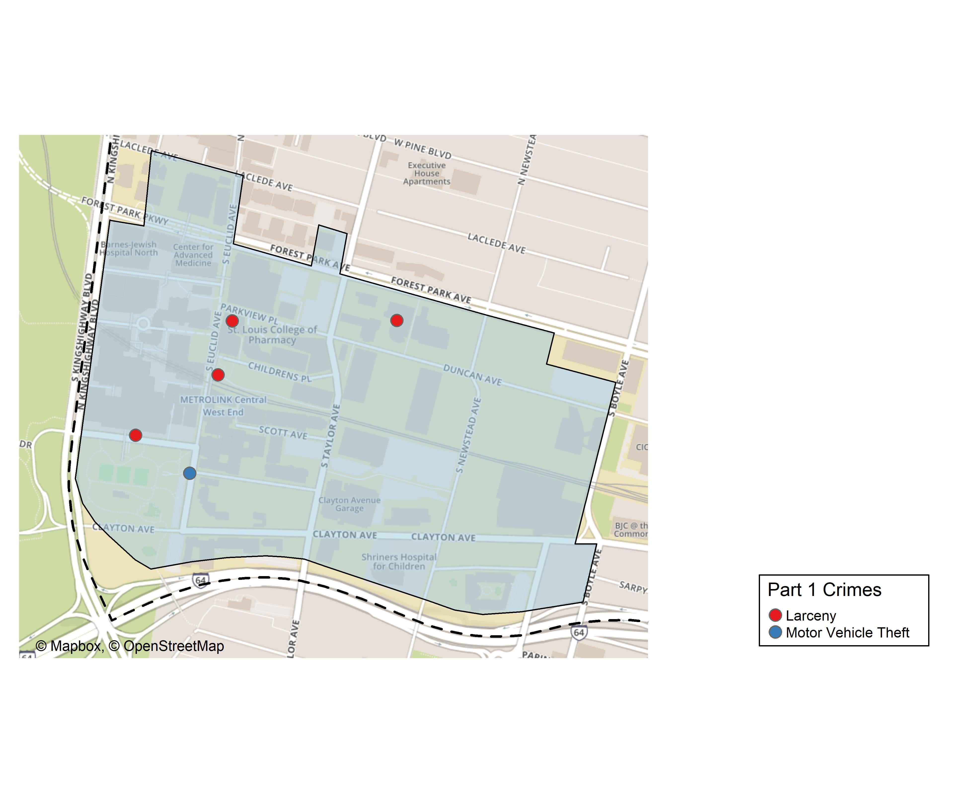
Washington University Medical Center: Total Crime Map

Slide 21
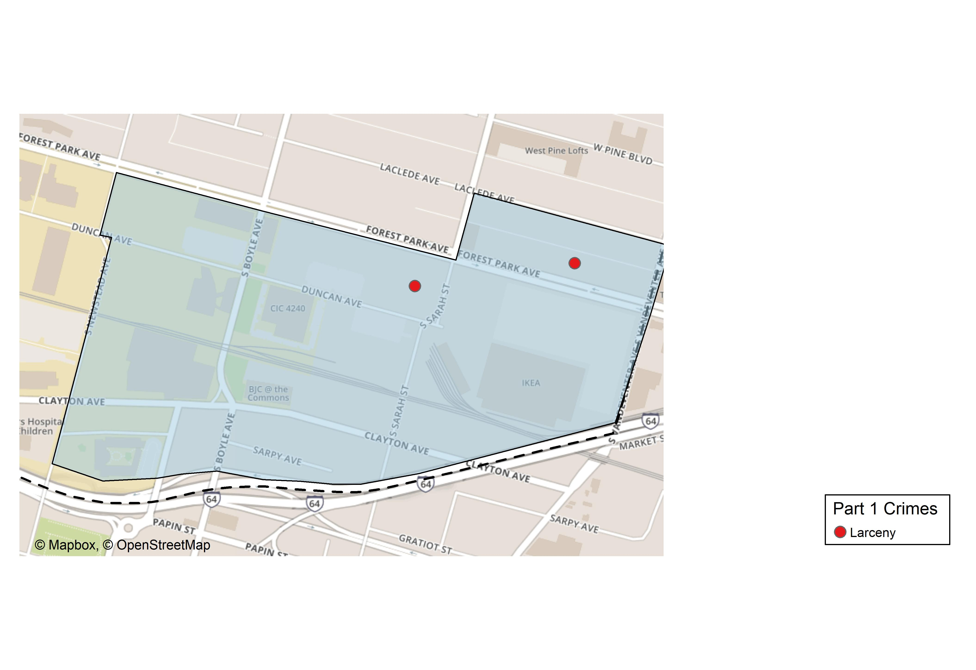
Cortex: Total Crime Map

Slide 22
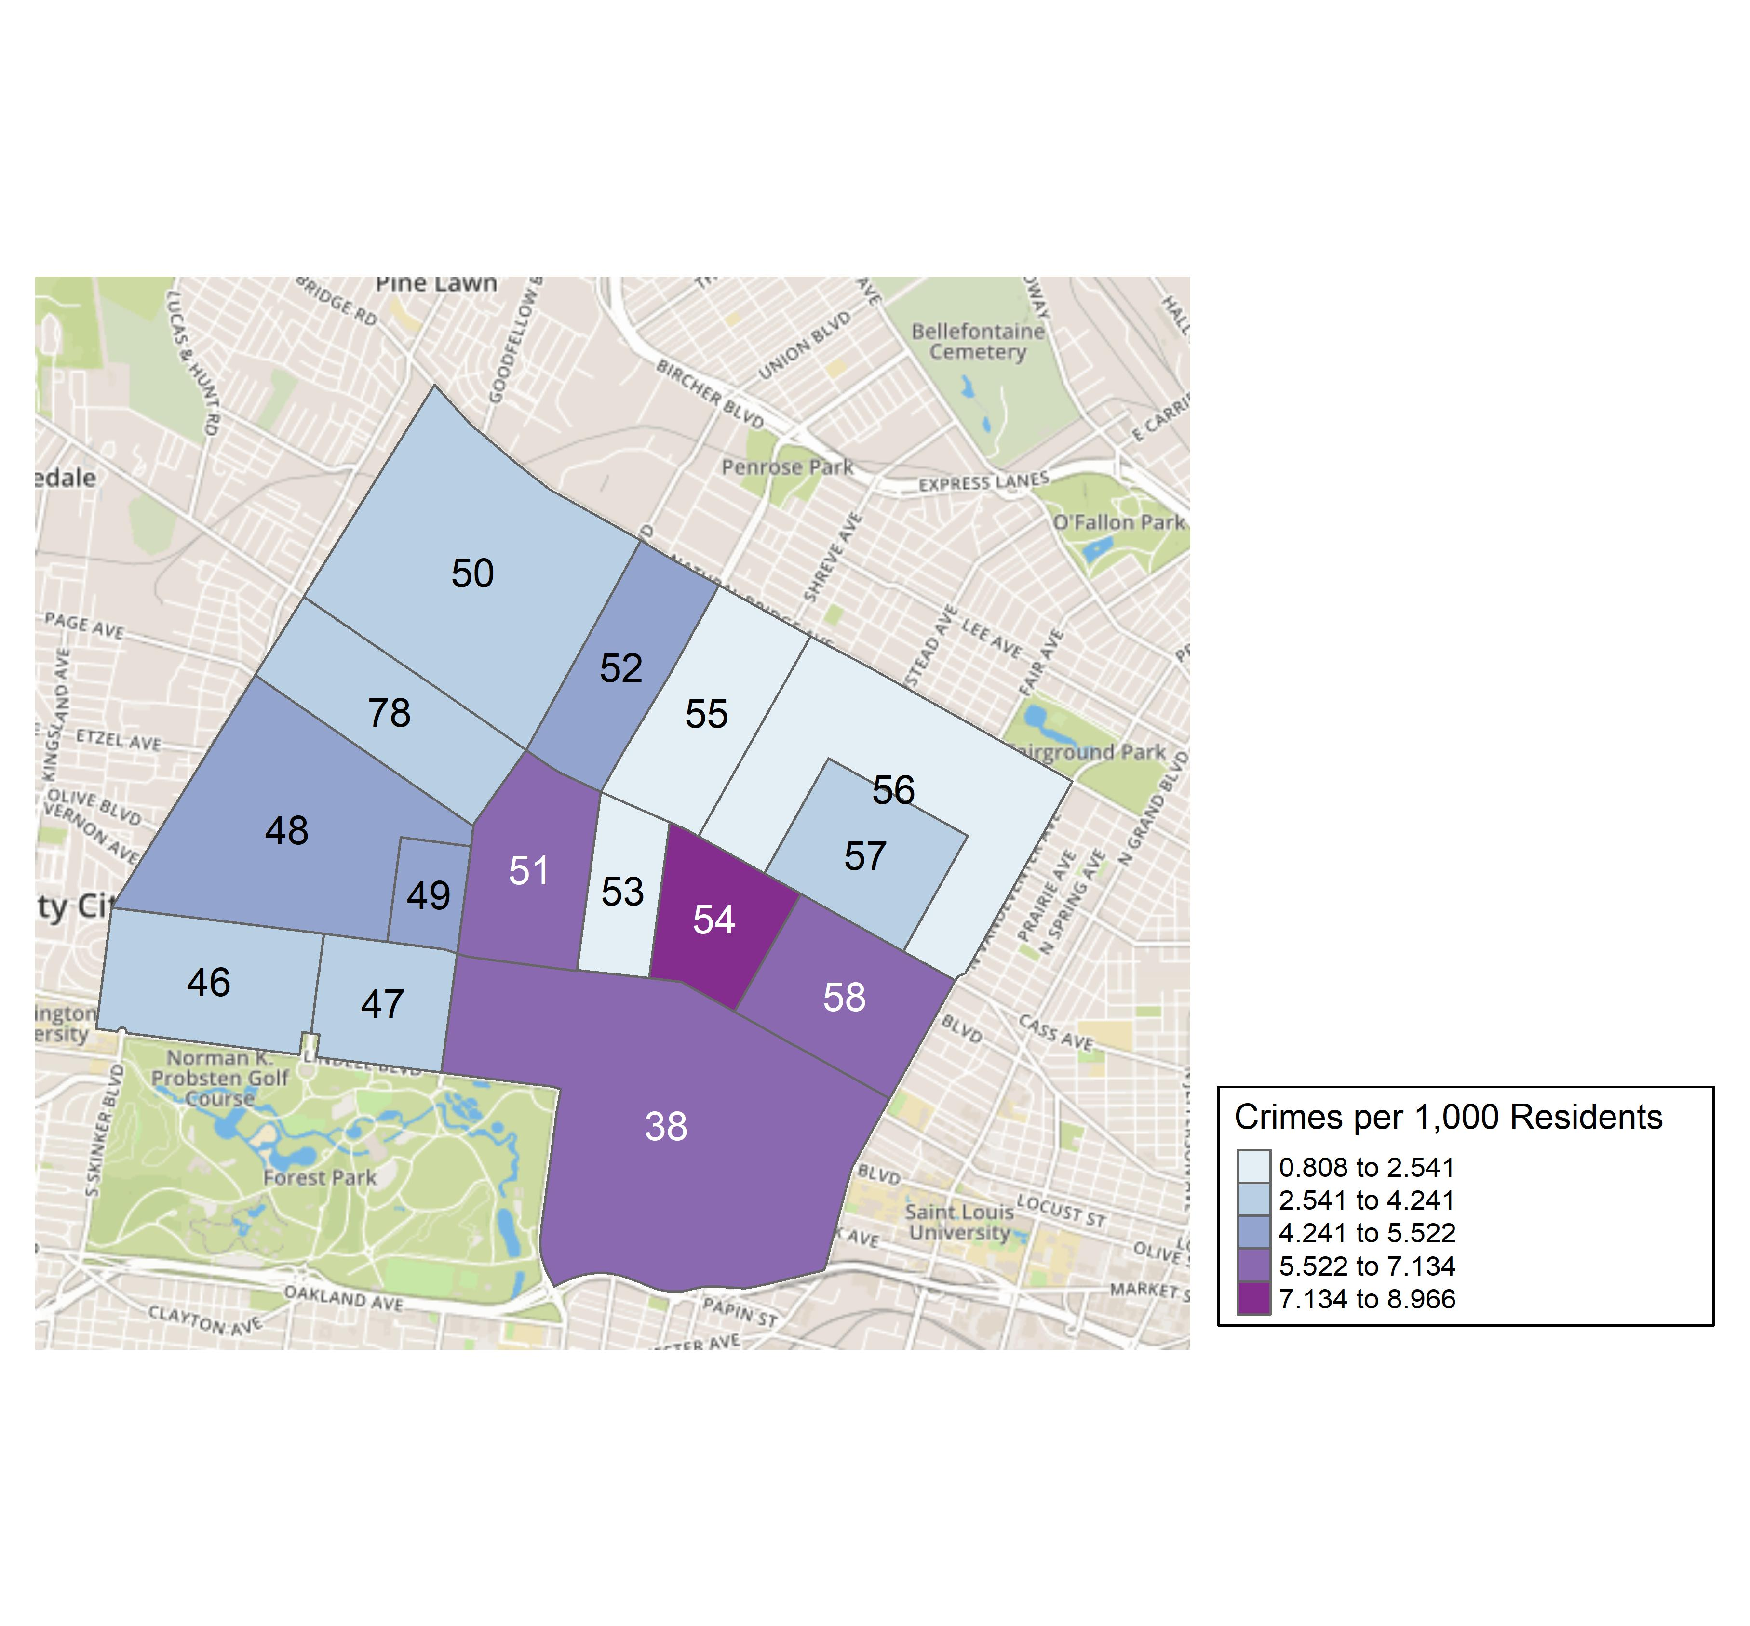
District 5: Crime Rates Map

Slide 23
District 5: Density Map Explanation
There are 15 neighborhoods in District 5.
The minimum number of crimes in one neighborhood was 3 (Fountain Park)
The maximum number of crimes in one neighborhood was 100 (Central West End)
The mean number of crimes in one neighborhood was 19.33
The minimum rate of crimes in one neighborhood was 0.81 (Greater Ville)
The maximum rate of crimes in one neighborhood was 8.97 (Lewis Place)
The mean rate of crimes in one neighborhood was 4.64

Slide 24
Forest Park Southeast: Neighborhood Detail
Appendix 1

Slide 25
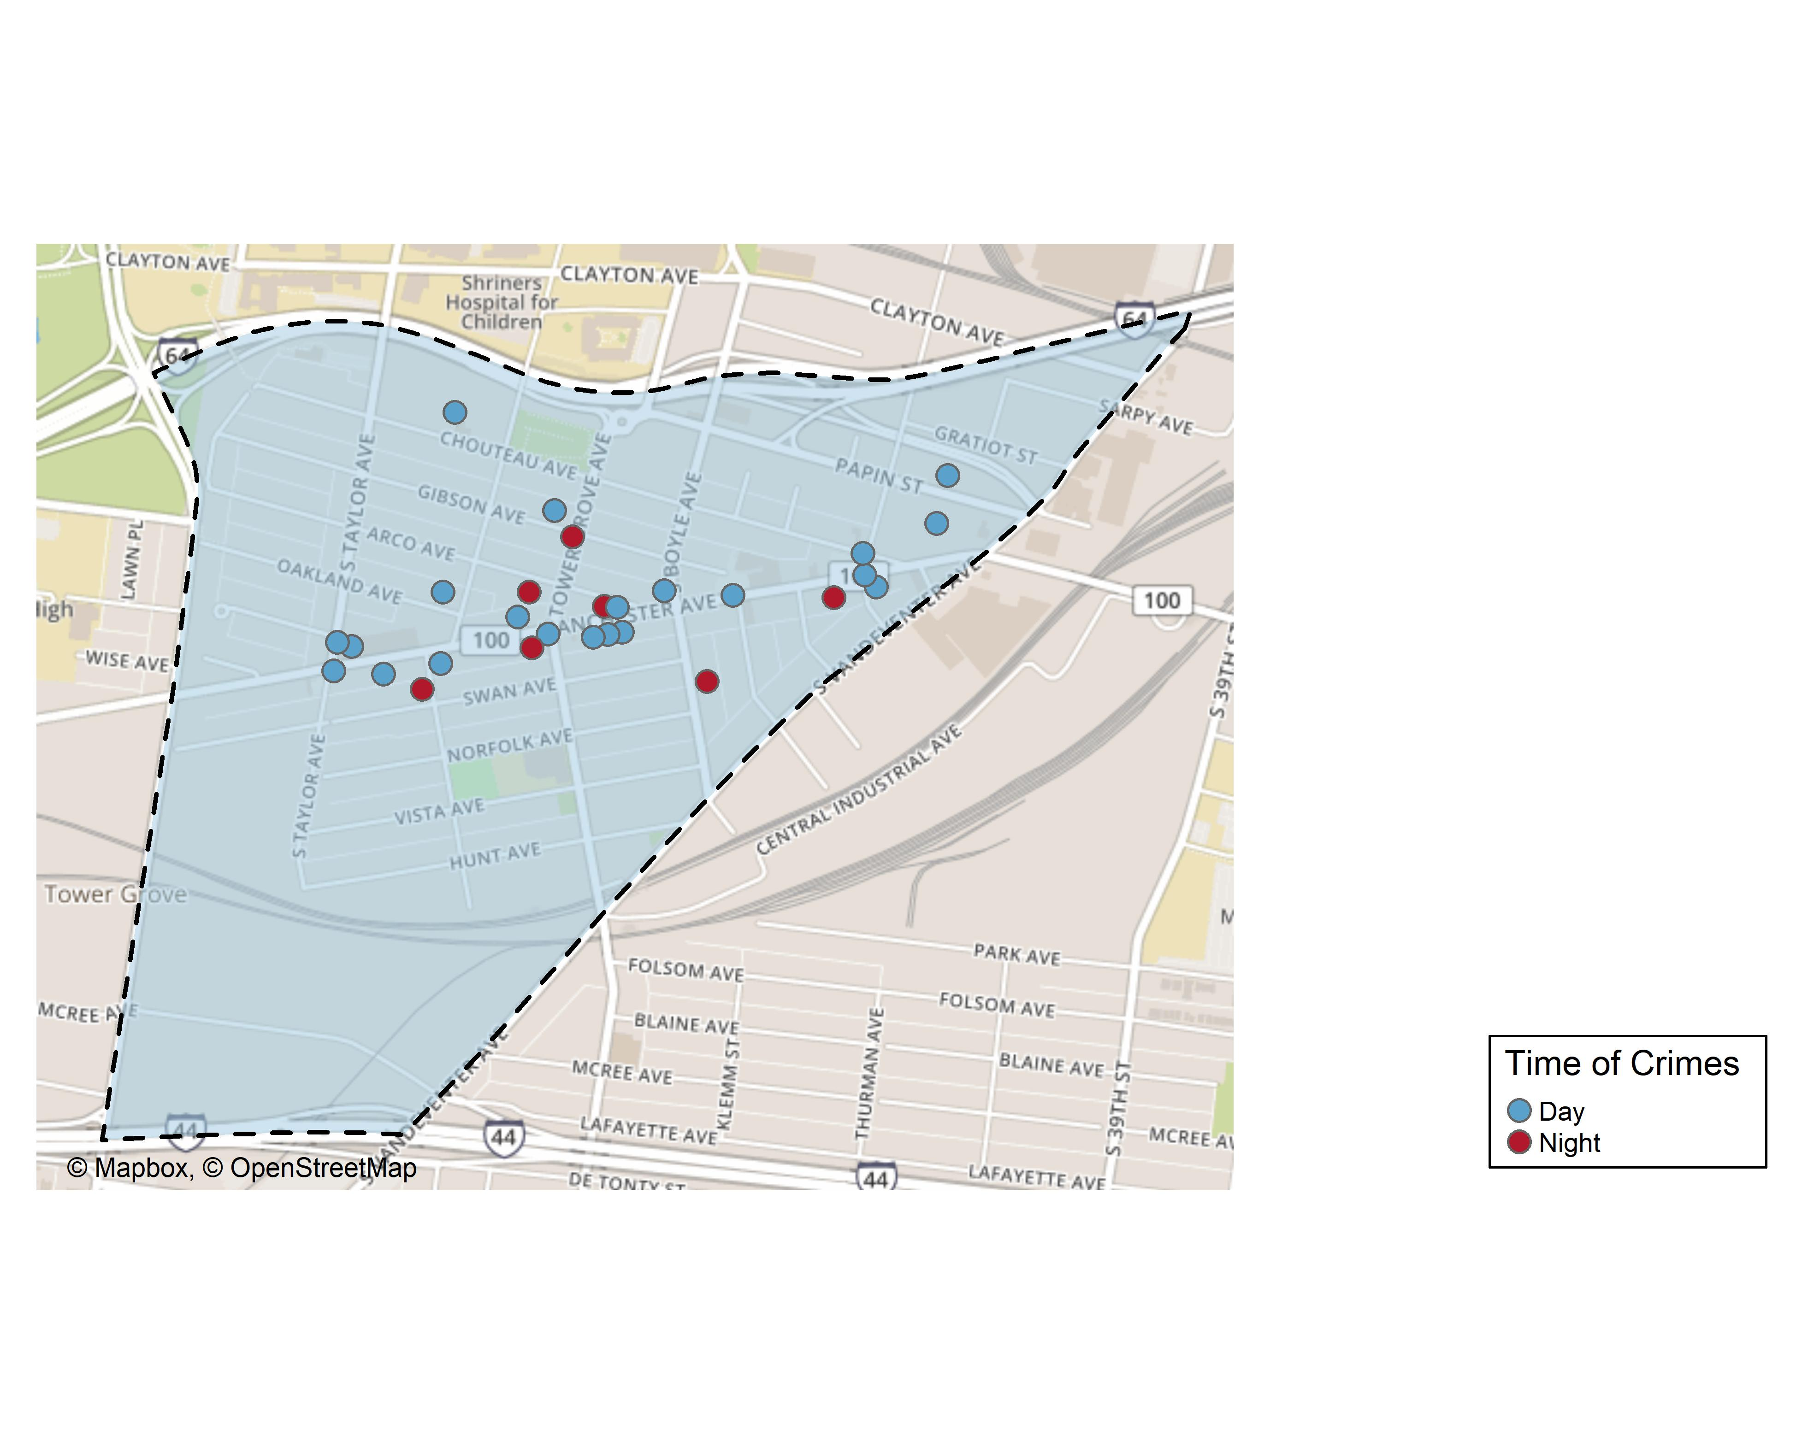
Forest Park Southeast: Time of Crimes Map

Slide 26
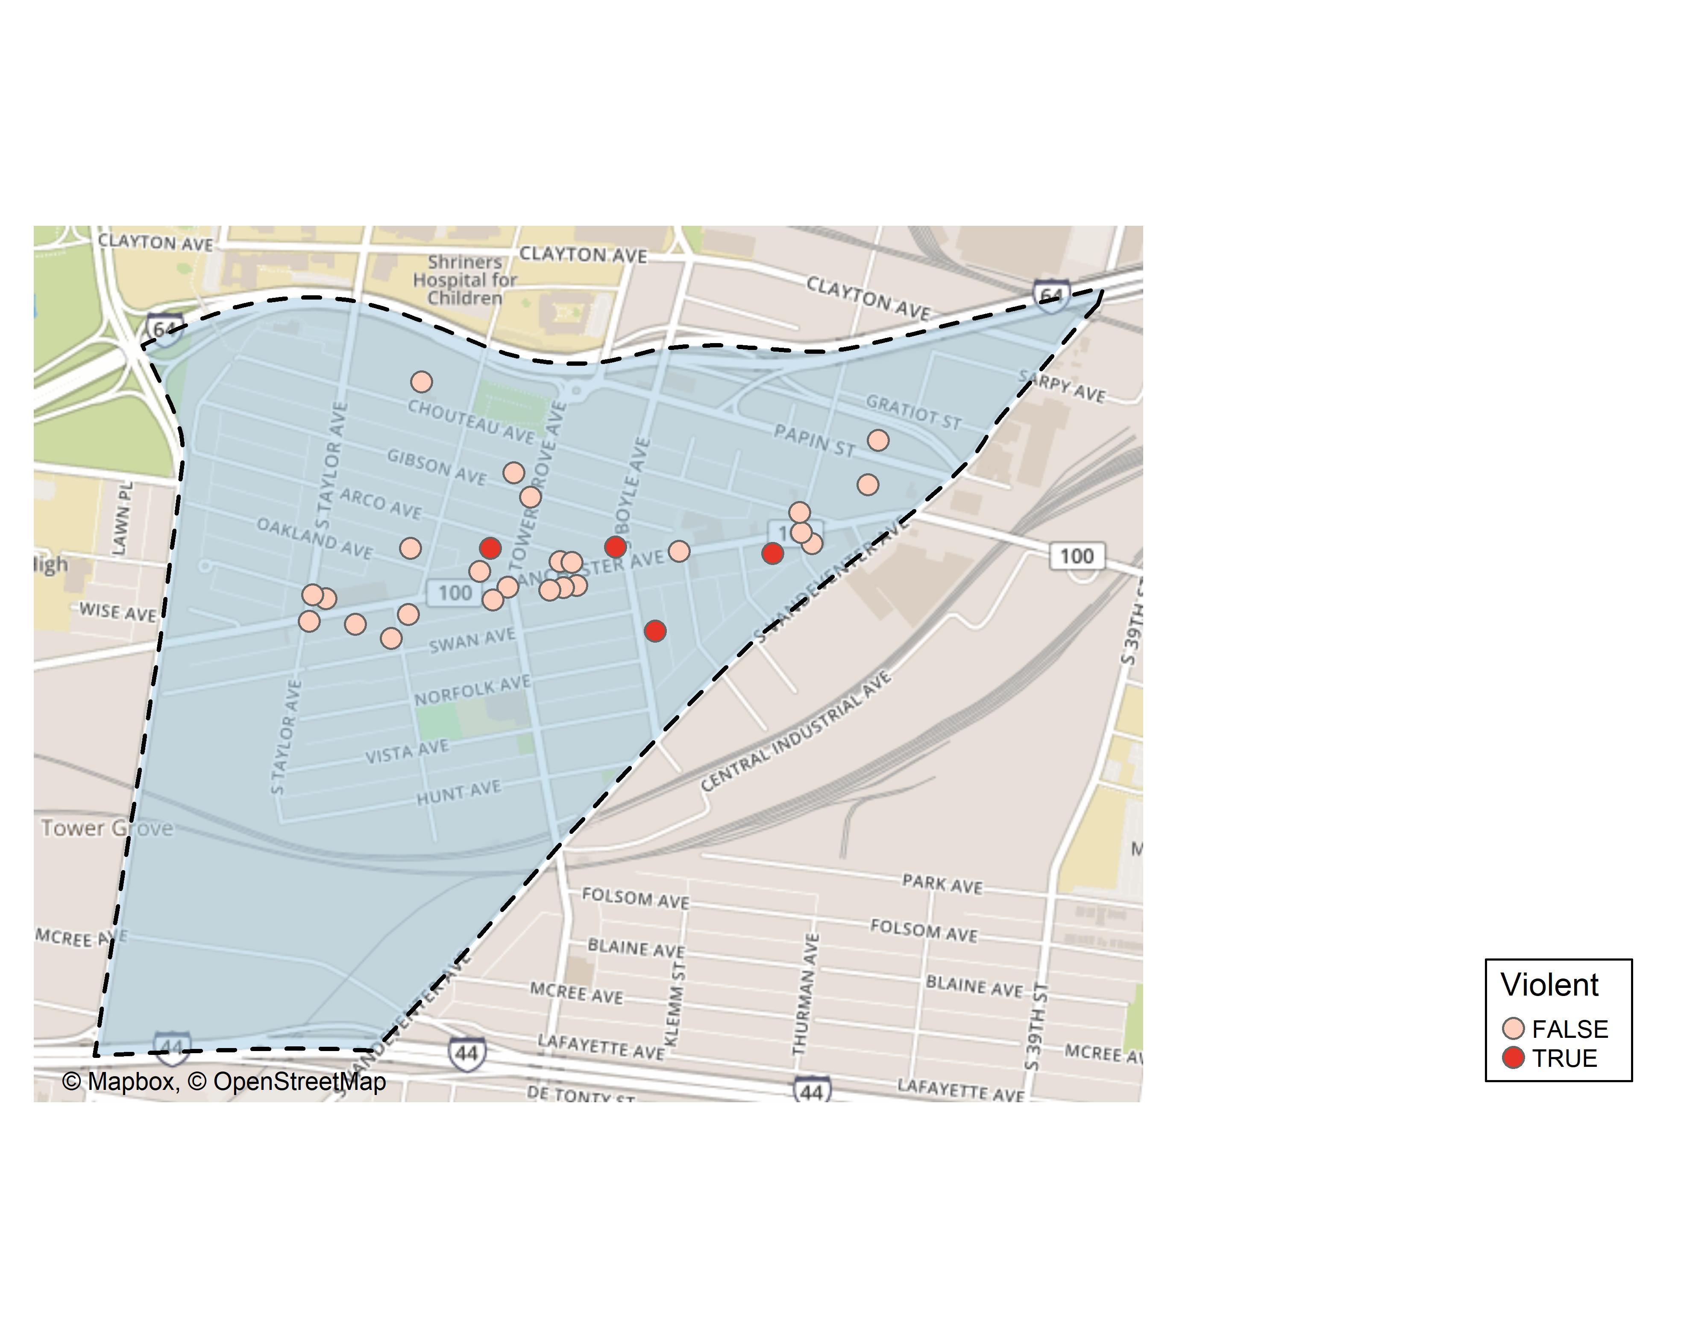
Forest Park Southeast: Violent Crime Map

Slide 27
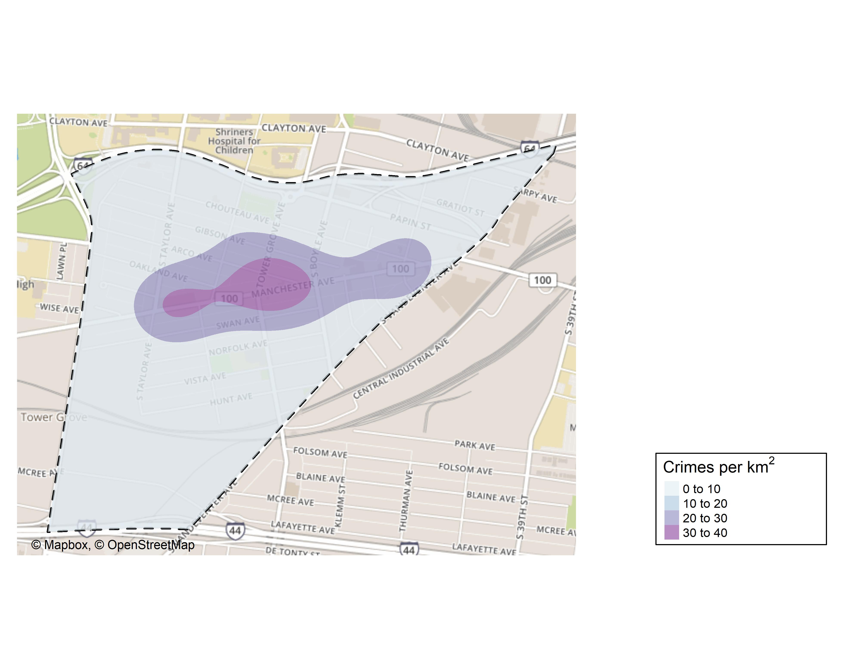
Forest Park Southeast: Crime Density Map

Slide 28
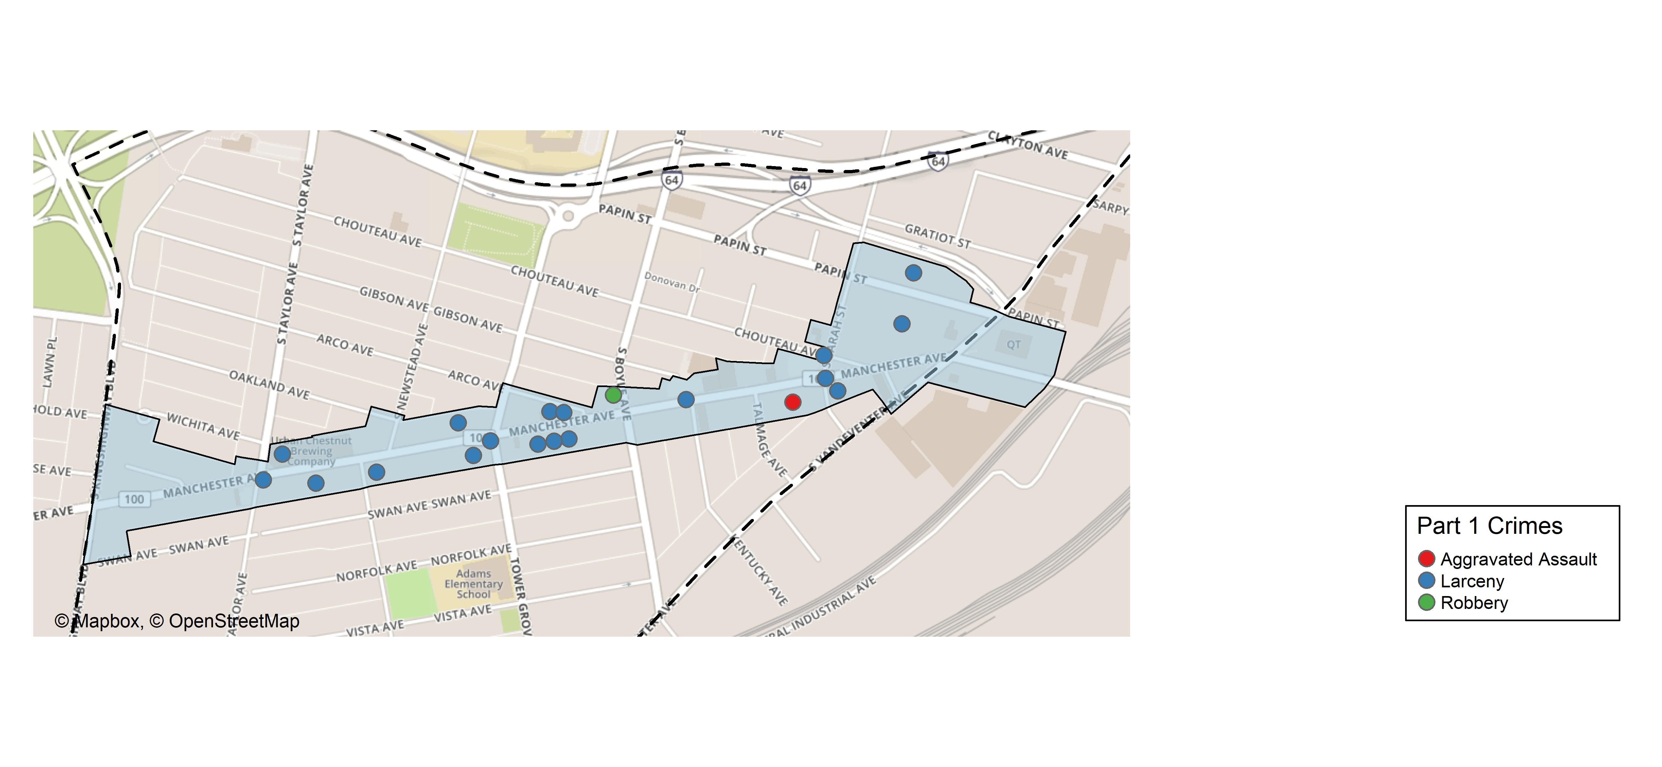
Grove Community Improvement District: Total Crime Map

Slide 29
Forest Park Southeast: Larceny Breakdown
Day of the Week | Number of Crimes
Sun | 5
Mon | 0
Tue | 3
Wed | 3
Thu | 4
Fri | 9
Sat | 8
Total | 32
Time of Day | Number of Crimes
Day | 28
Night | 4
Total | 32
Type of Larceny | Number of Crimes
All Other | 2
From Motor Vehicle | 30
Total | 32
Monetary | Number of Crimes
$500 - $24,999 | 15
Under $500 | 17
Total | 32

Slide 30
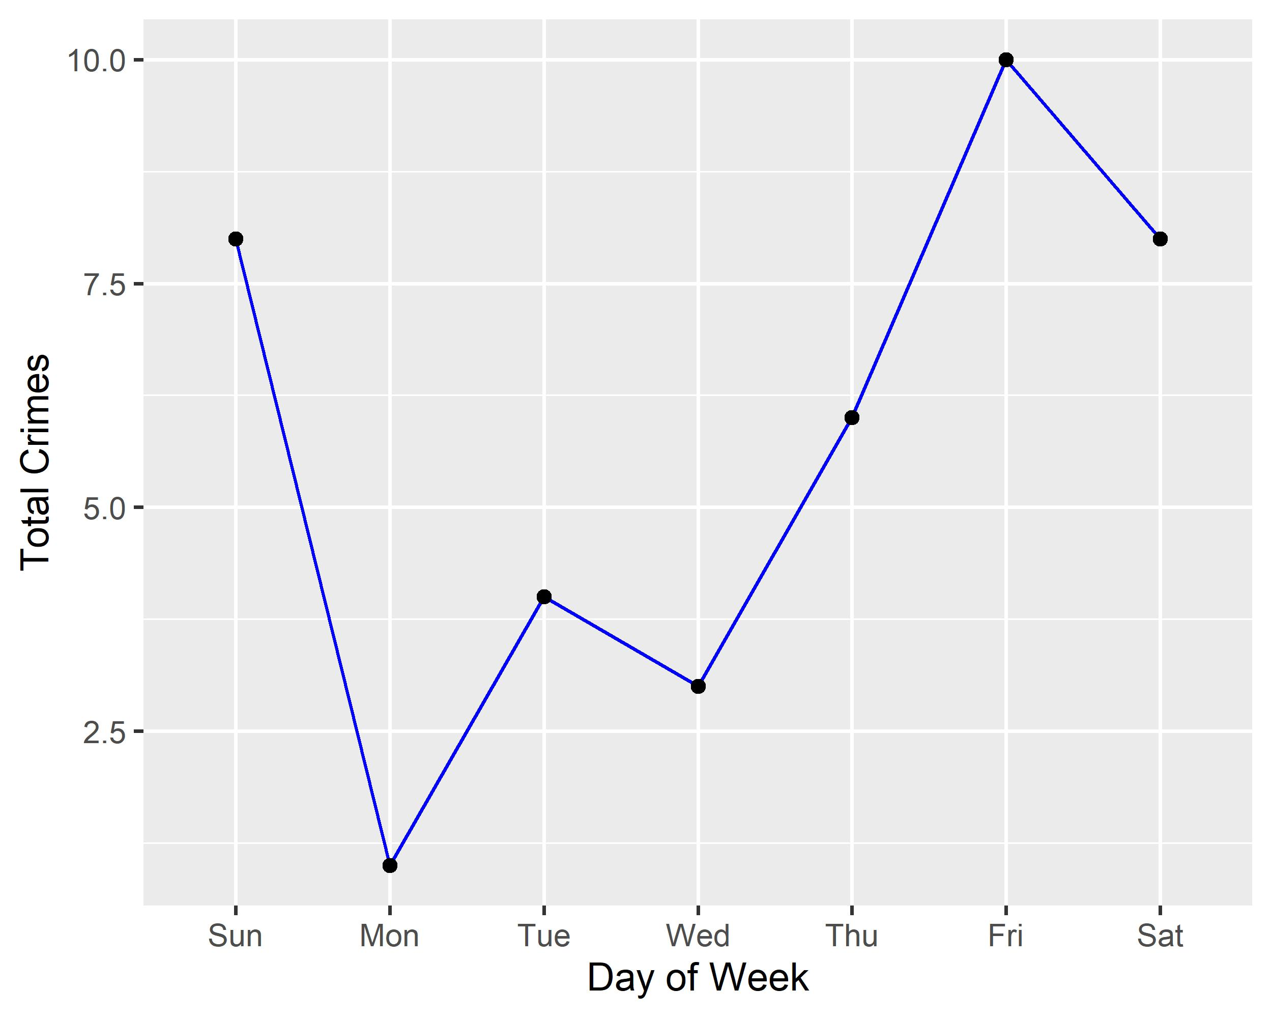
Forest Park Southeast: Total Crimes by Days of the Week

Slide 31
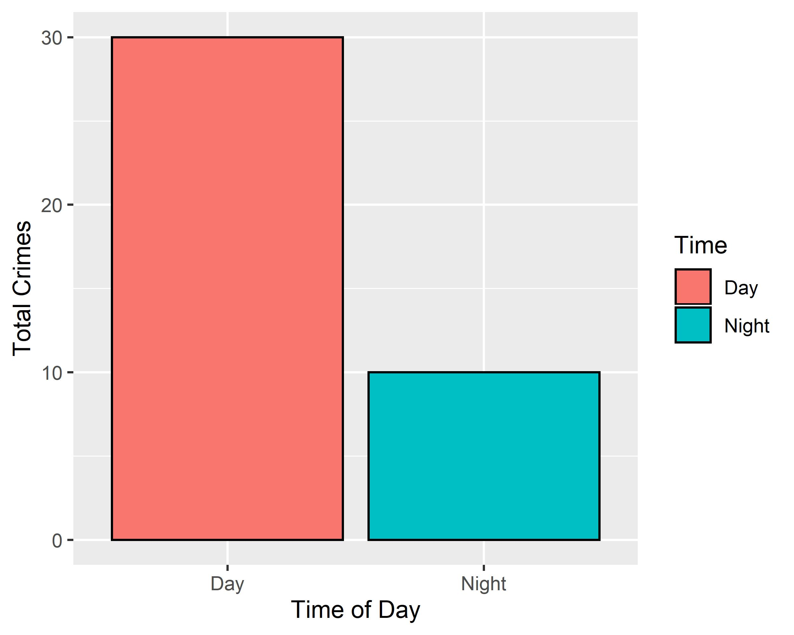
Forest Park Southeast: Crimes by Time of Day

Slide 32
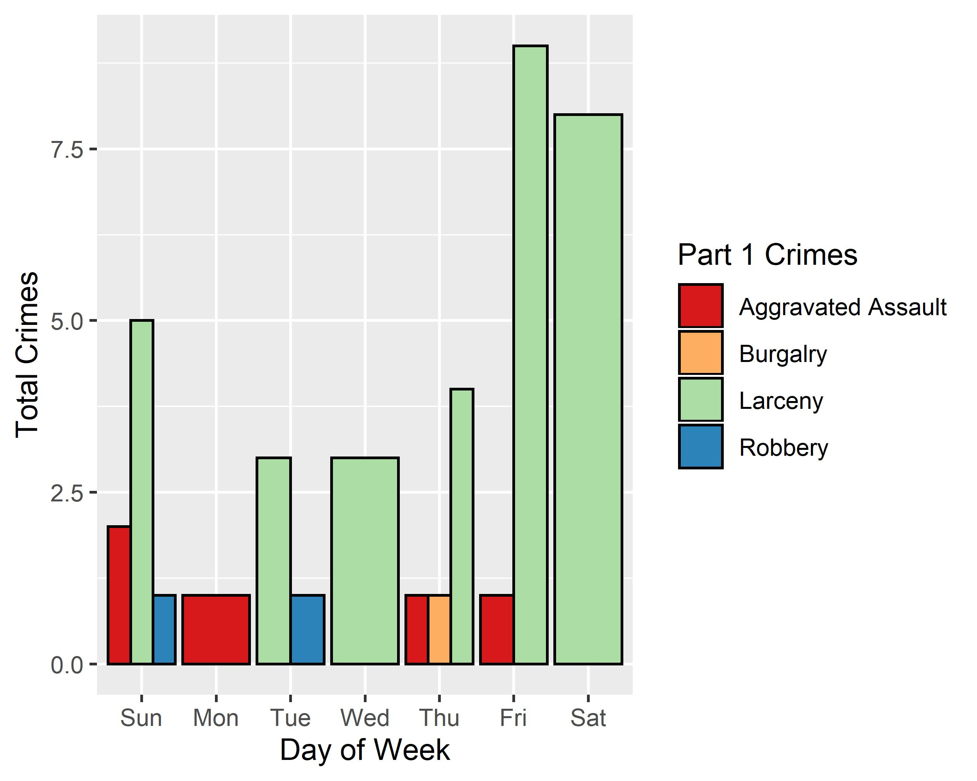
Forest Park Southeast: Crimes by Day & Category

Slide 33
Central West End: Neighborhood Detail
Appendix 2

Slide 34
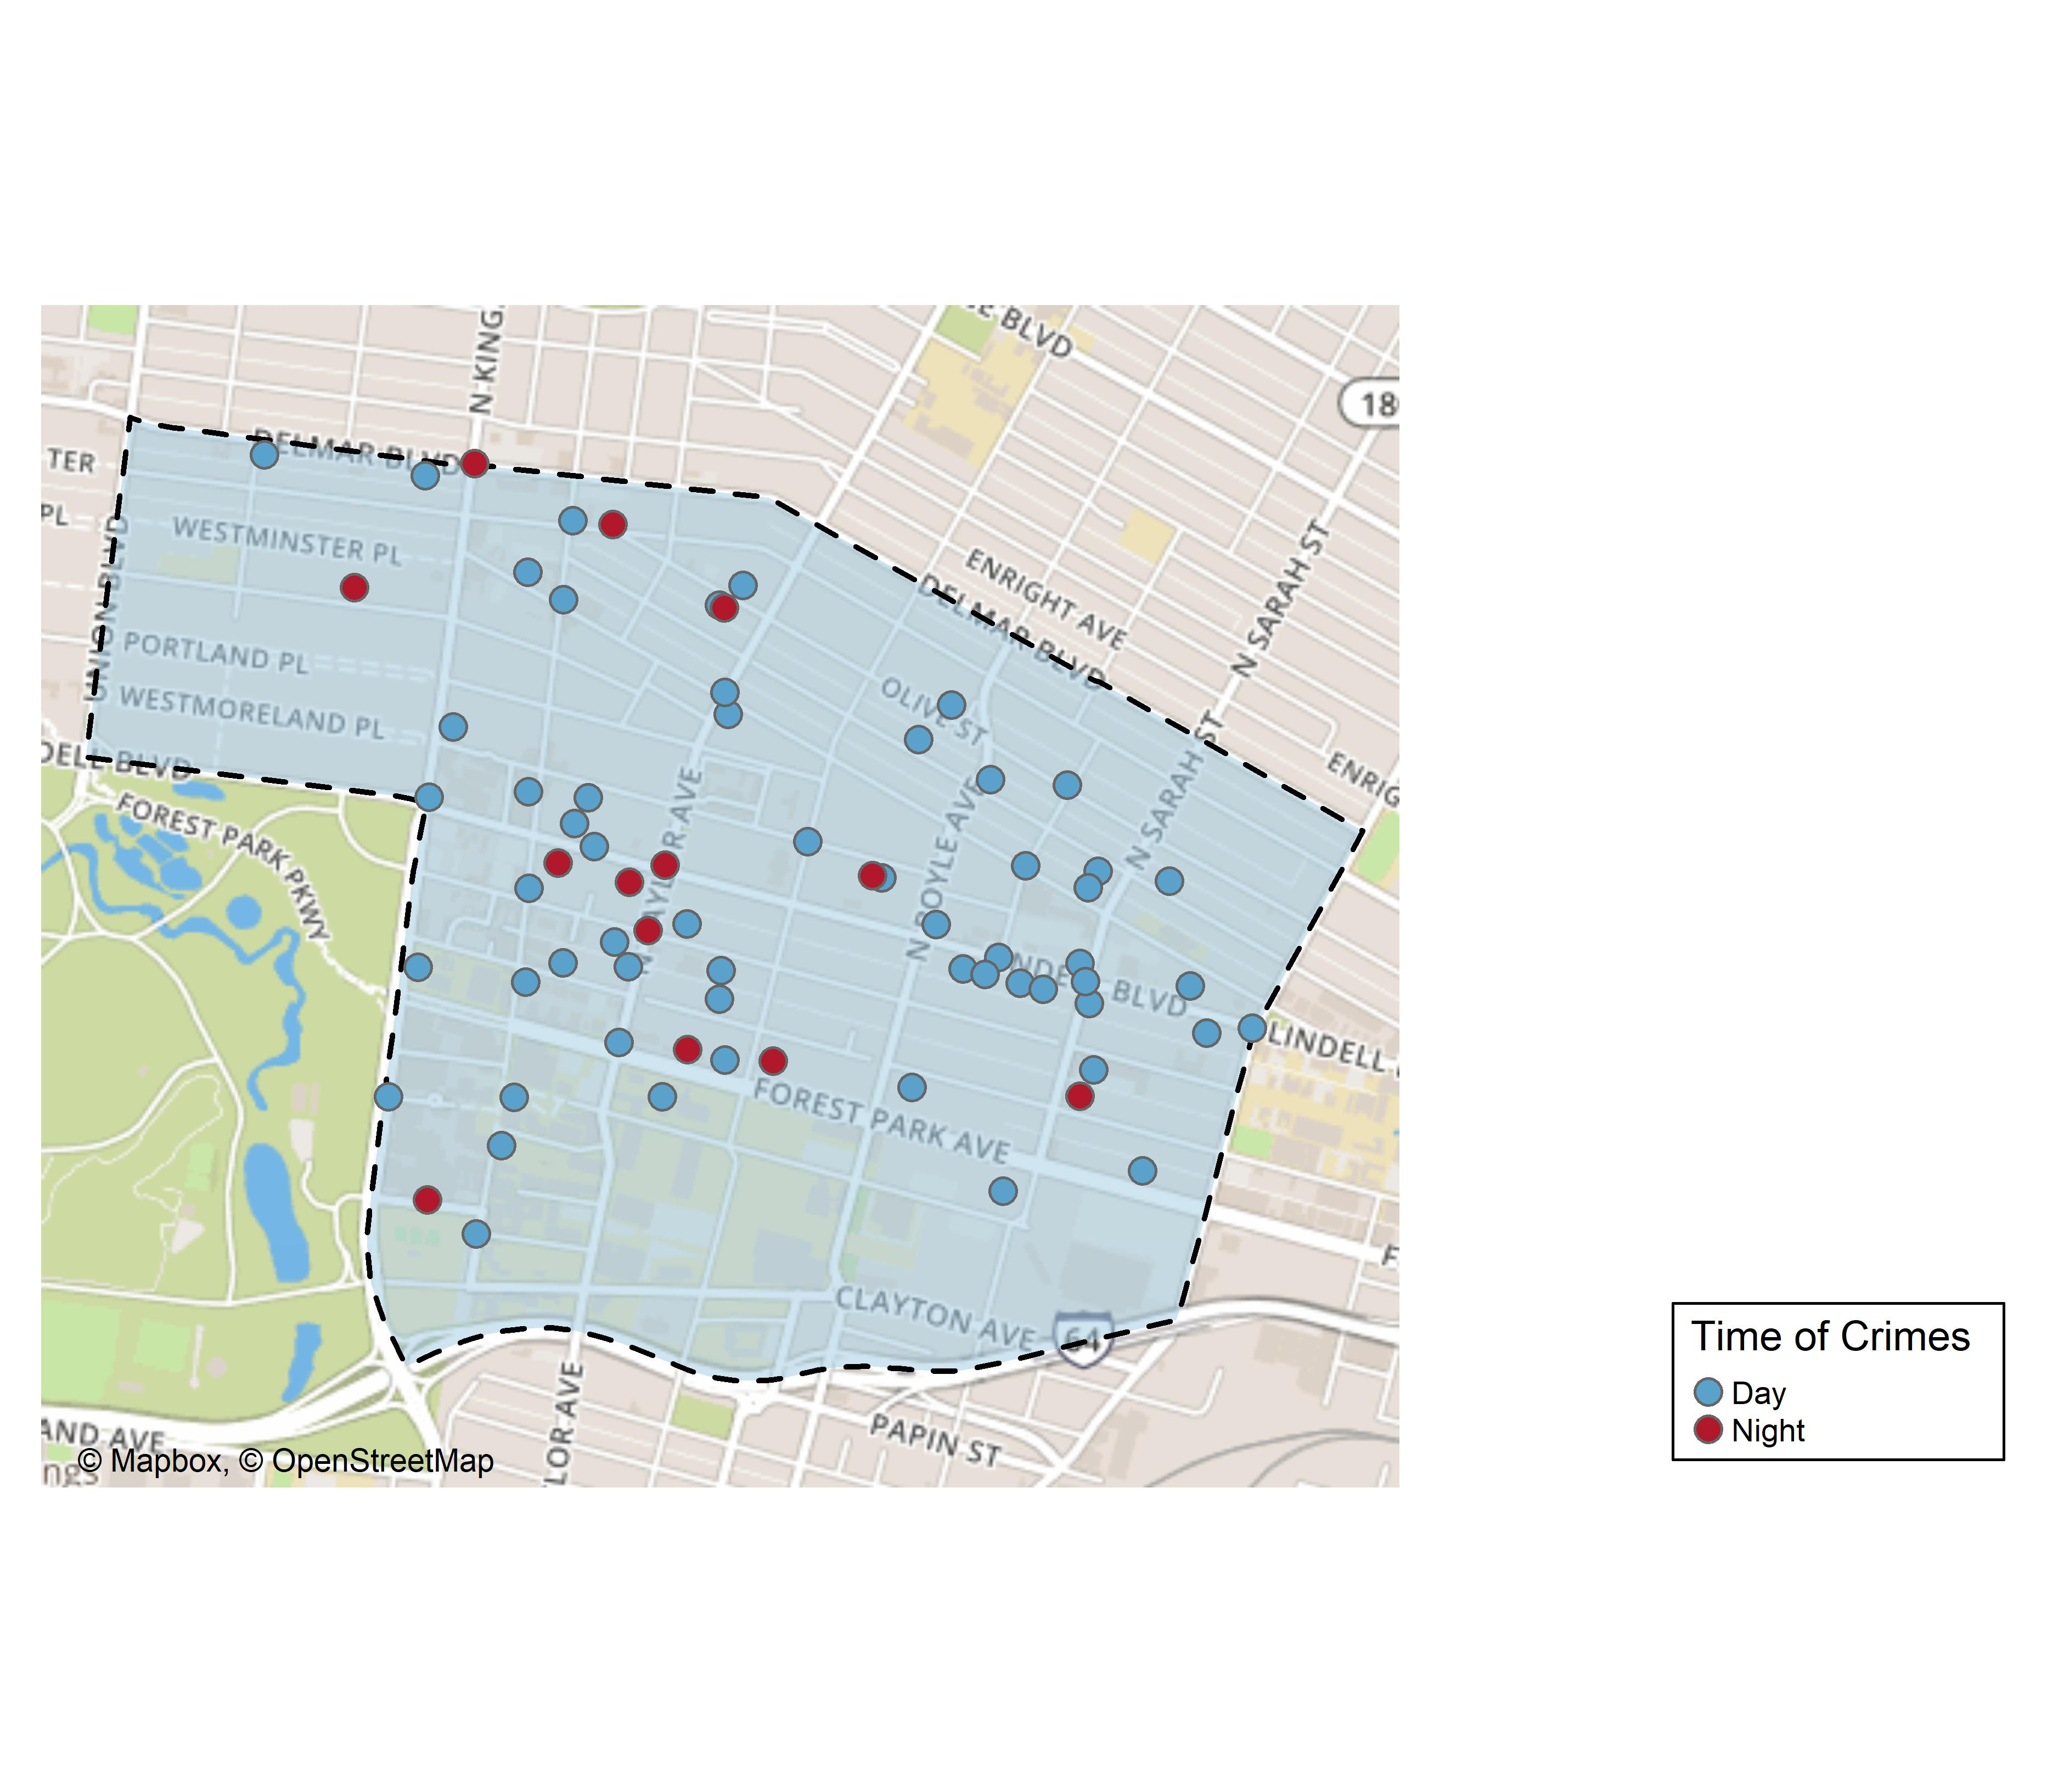
Central West End: Time of Crimes Map

Slide 35
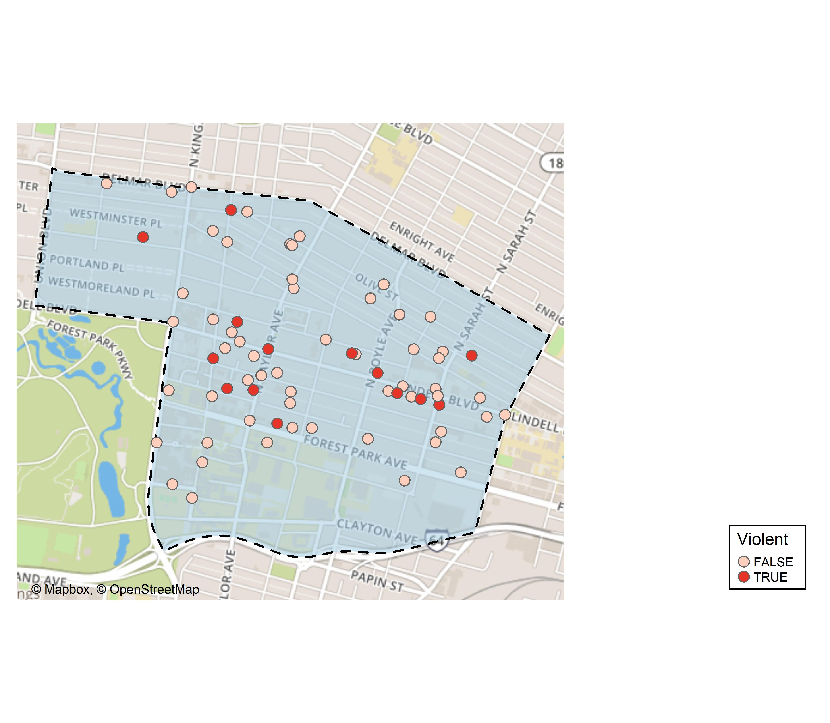
Central West End: Violent Crime Map

Slide 36
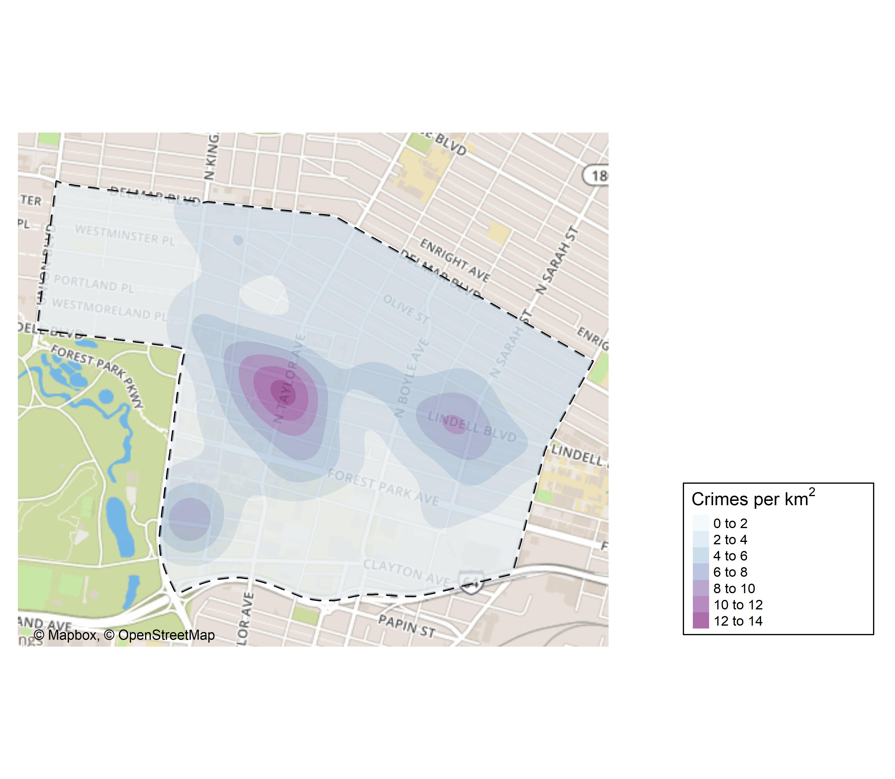
Central West End: Crime Density Map

Slide 37
Central West End: Larceny Breakdown
Day of the Week | Number of Crimes
Sun | 6
Mon | 9
Tue | 14
Wed | 7
Thu | 13
Fri | 10
Sat | 6
Total | 65
Time of Day | Number of Crimes
Day | 57
Night | 8
Total | 65
Type of Larceny | Number of Crimes
All Other | 9
Bicycle | 1
From Building | 11
From Motor Vehicle | 31
Motor Vehicle Parts | 8
Shoplifting | 5
Total | 65
Monetary Value | Number of Crimes
$500 - $24,999 | 14
Under $500 | 51
Total | 65

Slide 38
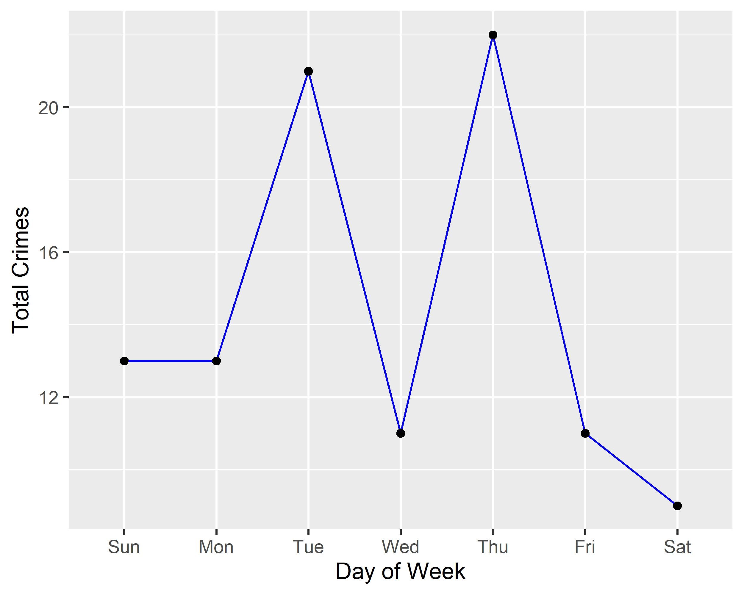
Central West End: Total Crimes by Days of the Week

Slide 39
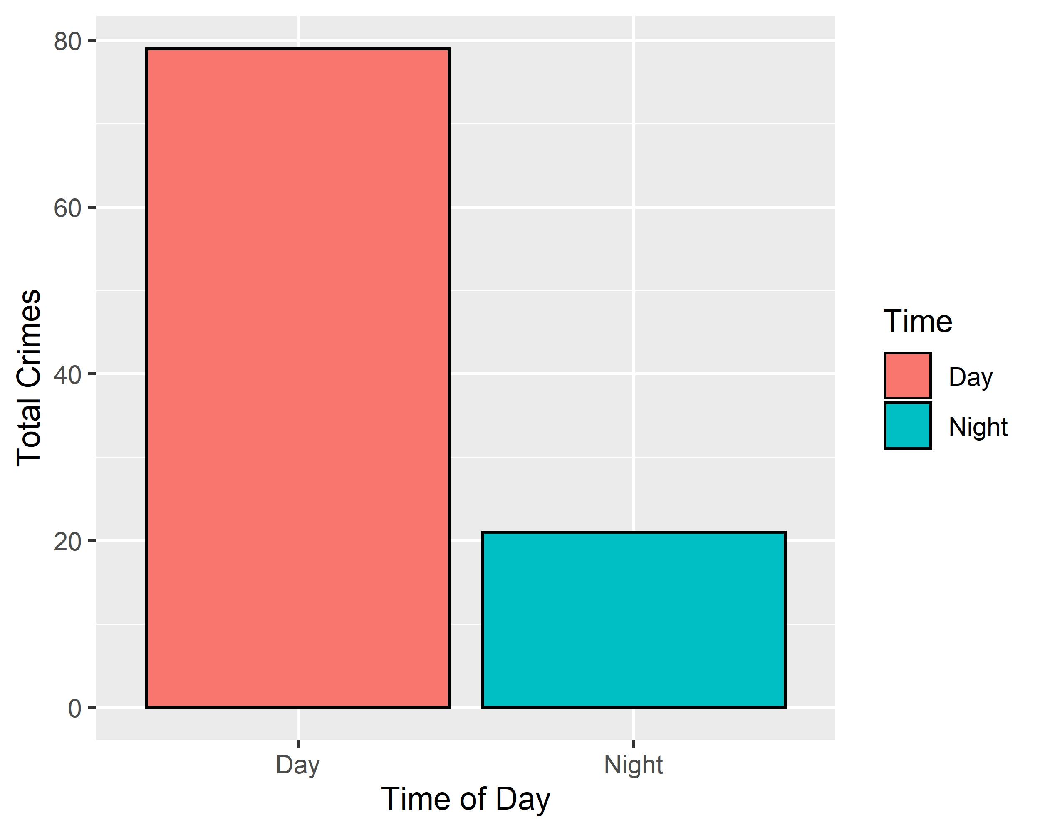
Central West End: Crimes by Time of Day

Slide 40
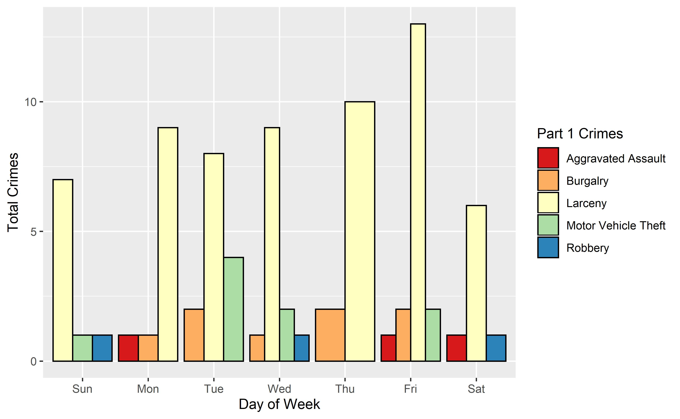
Central West End: Crimes by Day & Category

